Slide 1
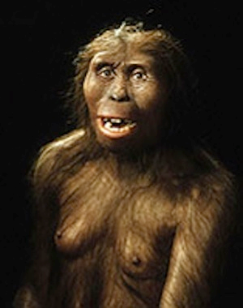
Lucy (Australopithecus)
Lucy is a 3.2 million year old Australopithecus Afarensis. She is a hominin and provides evidence the bipedalism came before the increase in brain size due to a small skull like apes, but the upright walk like that of humans. Her skeleton was found in Ethiopia in 1974 by Donald Johanson, Maurice Taieb, Yves Coppens, and Tom Gray. Lucy’s exhibit currently resides in Ethiopia.

Slide 3
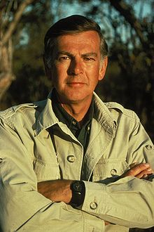
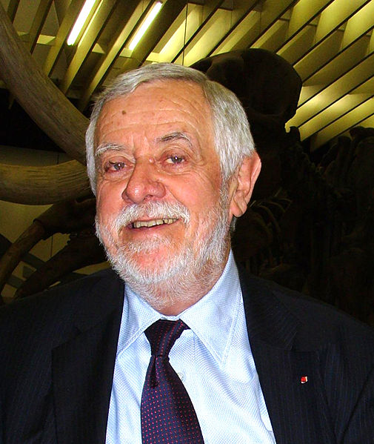
(Left) Donald Johanson an American paleoanthropologist
(Above) Yves Coppens a French anthropologist

Slide 4
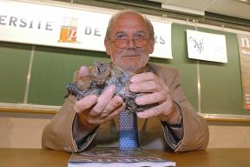
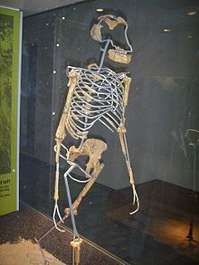
French Geologist Maurice Taieb holding the skull of Lucy
Replica of Lucy’s skeleton

Slide 5
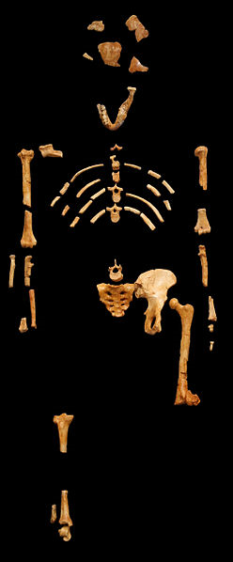
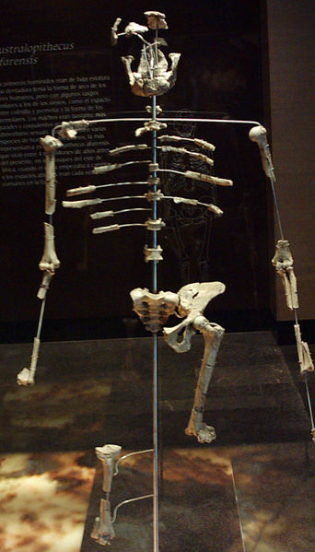
(Left) Lucy’s remains found in Ethiopia. Her catalogue number is AL 288-1.
(Right)Casts of Lucy’s remains in Mexico.

Slide 6
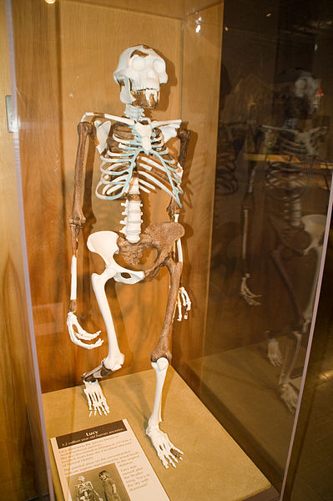
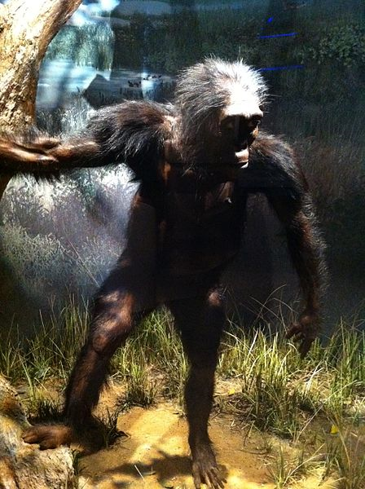
(Left) Another reconstruction of Lucy’s skeleton in the Cleveland Museum of Natural History.
This exhibit is a reconstruction at the National Museum of Natural History. Washington, D.C.

Slide 7
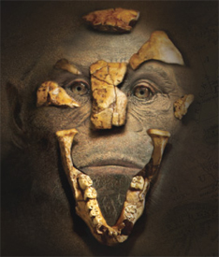
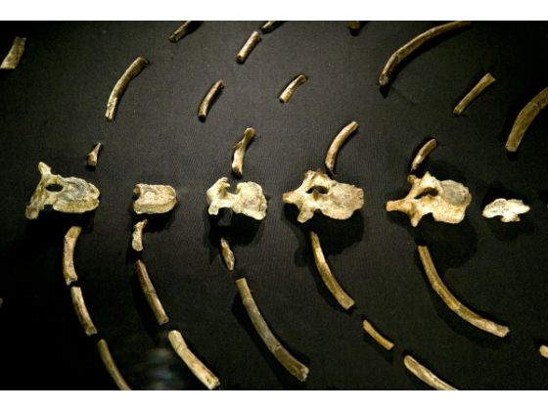
Rendering of Lucy including the found fragments of her skull.
(Right) Lucy’s ribs

